Slide 1


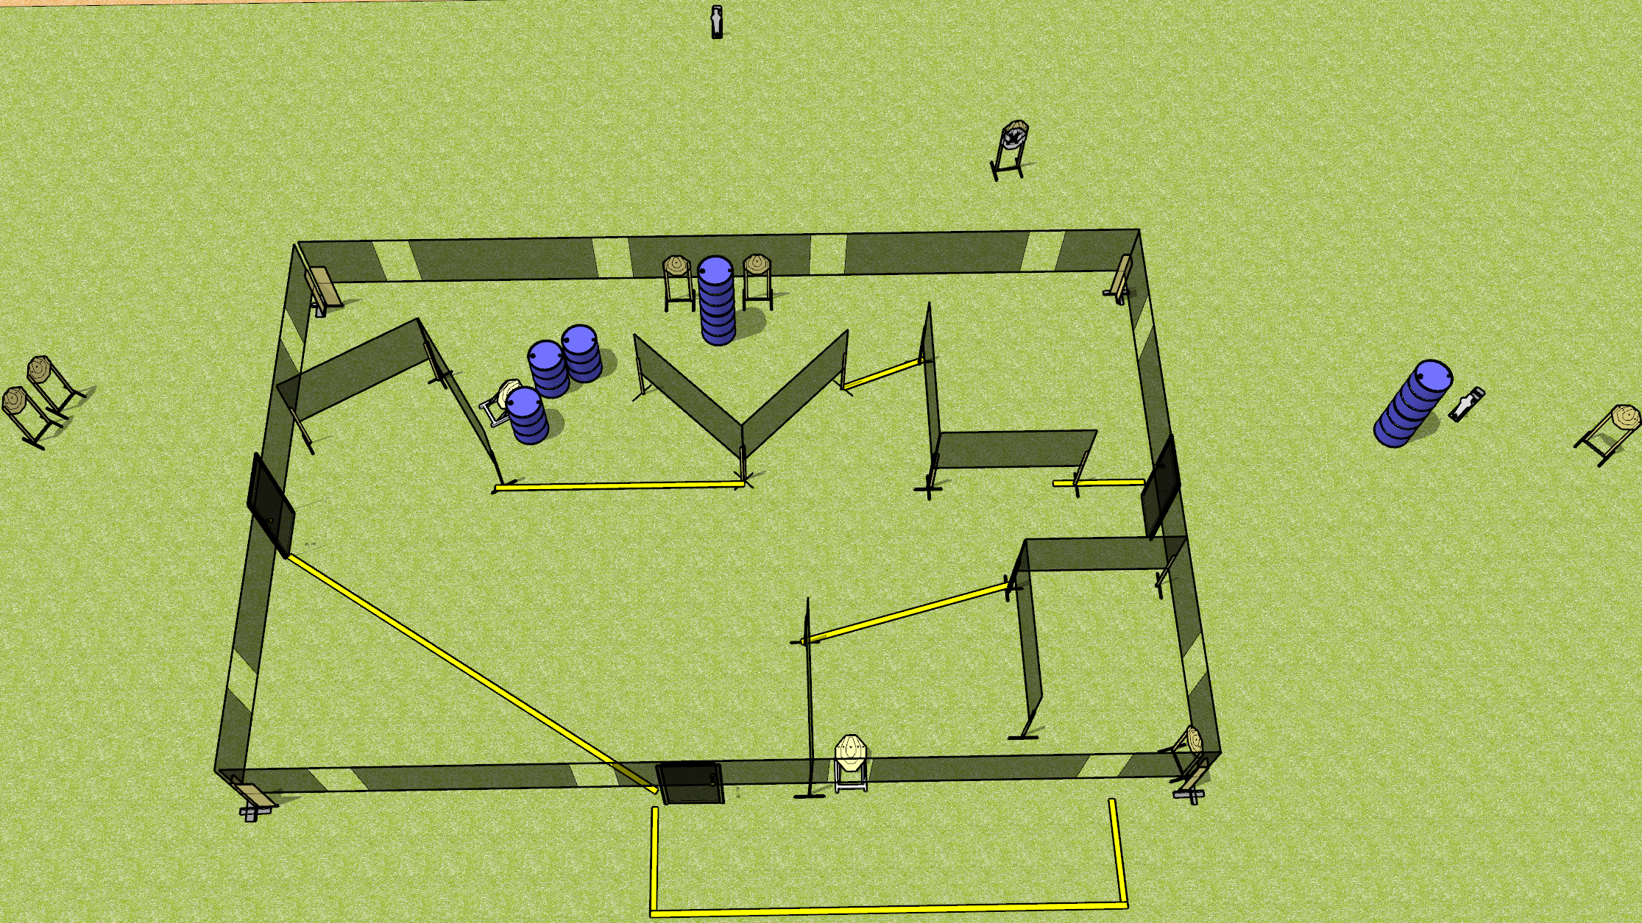
 | Dothan Gun Club – USPSA Match Leg Work Course Designer : Drew Coleman
Round Count 20 rounds 9 IPSC 2 mini poppers
Equipment List 2 wall feet 10 targets (9 + 1 NS)

Slide 2
Leg Work
Written Stage Briefing
Leg Work is a 20 round, 100-point, Comstock course of fire. There are 9 IPSC targets and 2 steel. The best 2 hits on cardboard will score and steel must fall to score.
Handgun start position is both hands touching marks on wall. Handgun is UNLOADED and holstered.
PCC start position is muzzle touching lower mark on wall. UNLOADED carbine is held with both hands.
On the audible start signal, engage targets as they become available from within the shooting area.

